Slide 1

Making this resource work for you
Prior to teaching this lesson, please refer to the ‘Unit Overview and Planning Document’.
Further guidance on planning Science Mastery lessons can be found in the detailed planning guidance document.
Refer to the ‘notes’ section on each slide for useful information, including suggested expositions, pedagogical content knowledge, suggested questions, answers and more. Consider using presenter mode so you can see this guidance throughout the lesson.
The introduction slides can be adapted to suit your teaching style and the needs of your class.
Before the lesson, adapt the fix-it slide to address any misconceptions identified in the previous lesson’s exit ticket.
Choose from the suggested activities to suit your class. The intention is not that you complete all of these, but that you select those which ones are most appropriate for your students. It may be appropriate to further adapt activities for your students.
These lessons are designed to occupy approximately 1 hour. To adapt for a shorter or longer lesson duration we advise you to adapt the activity section accordingly.
Please consider using the final slide to send feedback about this lesson or examples of PowerPoints that you have adapted to our design team. Your feedback is used to improve Science Mastery for all of our teachers and students. We appreciate all suggestions and comments.
Thank you for reading!
The Science Mastery Team

Slide 2


Scalars and Vectors
Answer the following questions:
State the definition of speed.
State the equation used to calculate speed.
State the SI unit for speed.
State the SI unit for mass and for weight.
Explain the difference between mass and weight.
The distance covered per unit time.
$$Speed=\frac{Distance}{Time}$$
Metres per second (m/s)
Mass: kg, Weight: N
Mass is the amount of matter in an object and weight is the effect of gravity on that mass.
Notes:
Foundation question: State the SI units for distance and time.
Answer: distance measured in metres, time measured in seconds.
Stretch: Calculate the speed (in SI units) of a runner who covers 5km in 30 minutes.
Answer: Speed = distance/time
Speed = 5000 m/1800 s
Speed = 2.78 m/s

Slide 3
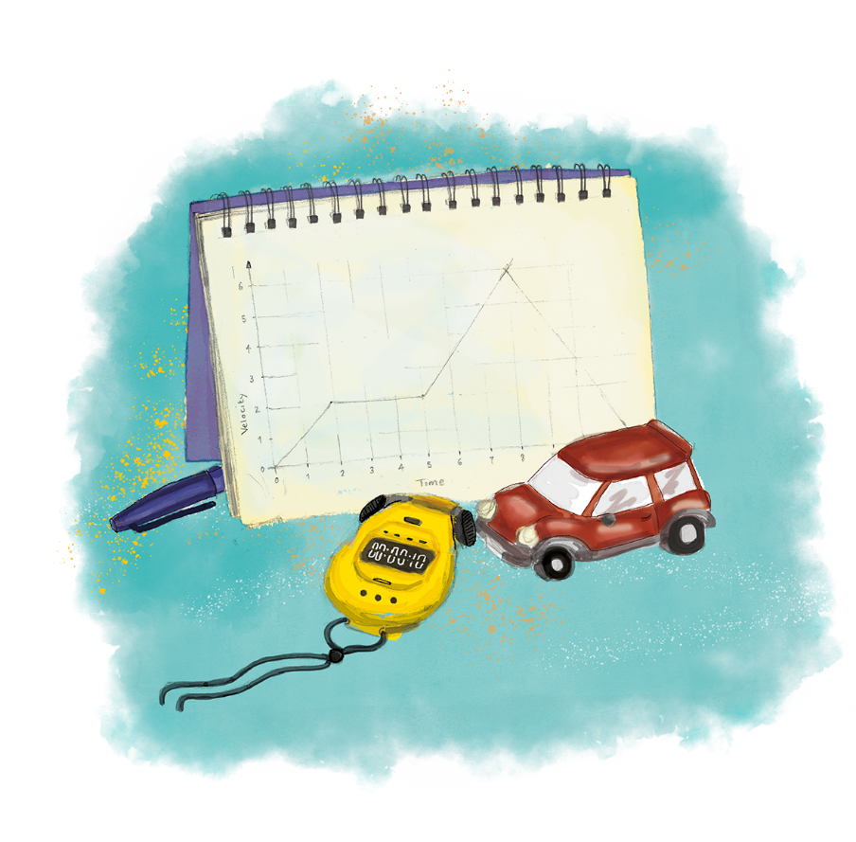

P3.1.2
16/10/2024
Scalars and Vectors
P3.1.1 Prior Knowledge Review
P3.1.2 Scalars and Vectors
P3.1.3 Resultant Vectors
P3.1.4 Resolving Vectors
P3.1.5 Newton's Third Law
P3.1.6 Newton's First Law
P3.1.7 Acceleration
P3.1.8 Acceleration Investigation
Maths in Science Lesson 17
P3.1.9 Velocity-Time Graphs
P3.1.10 Velocity-Time Graphs 2
P3.1.11 Acceleration Problems
Notes:
By this point pupils have learned about different scalar and vector quantities without classifying them as such. They have covered the difference between mass and weight, although not used a direction for weight and they have also learned that resultant forces must be written with a direction. In this lesson they will be introduced to the terms scalar and vector and different examples of each, which leads into further learning about velocity and acceleration as the rate of change of velocity.
Suggested Hook:
Put the following terms on the board and ask pupils to sort them in to two categories. They then need to discuss with their row and decide why they have placed them in these categories.
Speed
Distance
Time
Force
Weight
Energy
Acceleration

Slide 4

Following this lesson, students will be able to:
Define scalar and vector quantities
Explain the difference between speed and velocity
Calculate speed and velocity
Key Words:
scalar
vector
speed
velocity
distance
displacement

Slide 5
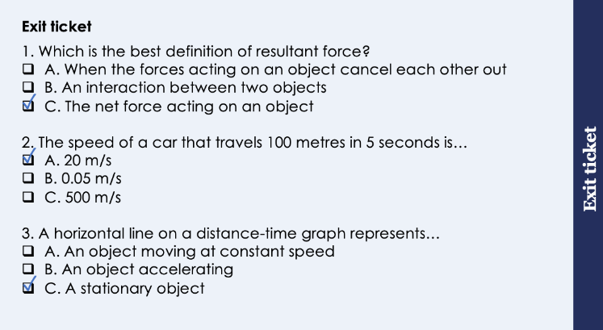
This is the fix-it portion of the lesson
The fix-it is an opportunity to respond to gaps in knowledge, especially those identified by the previous lesson’s exit ticket.
The teacher should customise this slide as needed, to facilitate
reteach, explanation, demonstration or modelling of ideas and concepts that students have not yet grasped or have misunderstood.
practise answering specific questions or of key skills.
redrafting or improving previous work.
Notes:
Suggested Guidance from previous exit ticket:
Q1. Answer: C
If students answer A they have confused balanced forces and resultant forces and if pupils answer B they have used the KS2 definition of a force. To fix-it, give pupils scenarios of zero and non-zero resultant forces and ask them to calculate resultant force and state whether forces are balanced or unbalanced.
Q2. Answer: A
If students answer B or C they have not used the equation to calculate speed correctly. To fix-it, give pupils further practice of calculations of speed questions.
Q3. Answer: C
If students answer A they have recognised the speed is not changing but not that the speed is 0 so the object cannot be moving. If students answer B they have not understood the meaning of acceleration and may have confused speed and acceleration. To fix-it, give pupils a distance-time graph and ask them to describe the motion of the object shown. They could practice calculating speed and describing relative motion during each phase of the graph. It is crucial their understanding of distance-time graphs is secure before moving on to velocity-time graphs.

Slide 6
General Definition
Scientific Definition
Noun: An organism that transmits a disease or parasite from one plant or animal to another.
From the Latin vehere meaning ‘to carry’.
A physical quantity that has both magnitude and direction.
Vector
‘Happiness is not a state of being. Happiness is a vector, it is movement.’
Neal Shusterman
Synonyms
General Examples
Transmitter
Carrier
Mosquitos are a vector of malaria.
Scientific Examples
Force is a vector because it has both magnitude and direction.
Notes:
Purpose of this slide:
The purpose of the Frayer organiser is to address key scientific vocabulary that students may be familiar with from a non-scientific context. Addressing this at the beginning of the lesson limits the potential cognitive conflict that might arise if students are using their current non-scientific interpretation of a term to understand the science being learned. This approach limits the potential for misconceptions and confusion arising from differing scientific and non-scientific uses of the same word.
The use of this slide is intended to clearly show students
how a word can have both scientific and non-scientific meanings simultaneously
the correct usage of a word in both a scientific and non-scientific context
Teacher guidance:
This slide should be used briefly. Do not dwell on each portion of the slide as this can eat into the lesson quite quickly.
This might be an apt opportunity to ask students to write the scientific definition of the key term into their books. Alternatively, you may want to wait to do this until the term is addressed in more depth later in the lesson.
Suggested narration:
Here we have the word ‘X’. You many already be familiar with this word [display general examples and general definition] in this context. Well, in science, we use this term slightly differently. [display scientific example]. [Display scientific definition]. In science when we use this word what we actually mean is this. You can see that words which mean the same include X,Y and Z. Words that mean the opposite include A, B an C. From this point in the lesson when we refer to this word we’ll be using it in the scientific sense.

Slide 7
Scalars and Vectors
A scalar is a quantity that only has magnitude (size).
Examples of scalar quantities are distance, speed and energy.
Examples of vector quantities are displacement, velocity, acceleration and force.
A vector is a quantity that has magnitude (size) and direction.
5 N
Notes:
Exposition type: explanation
Suggested exposition:
In physics we talk a lot about physical quantities, which is a scientific way of saying ‘something that can be measured’. We have already learned about lots of these, including speed, distance, time, mass, weight and energy. Physical quantities can be categorised into two groups - scalars and vectors.
Scalar quantities are quantities (remember that just means something that can be measured) that are fully described just with a magnitude, which is the scientific way of saying size. All this means is that when writing or describing a scalar quantity, the answer is complete just with its size. For example, distance is a scalar quantity because a measurement of distance is described just with its size, for example 100 metres.
Vector quantities are quantities that are described with a direction as well as a magnitude. As we learn more and more physics we will look at more vector quantities but the one you may be most familiar with already is force and resultant force, for example 10 N to the left. We always have to describe force with a direction (unless the forces are balanced are the resultant force is 0 N) because force is a vector quantity.
Note: Mass and weight have been purposely omitted from these examples so that pupils can decide for themselves in the talk task.
Note: pupils may be familiar with the movie ‘Despicable Me’ where the villain is called Vector (and says he is committing crimes with magnitude and direction), which can be a silly but easy way to remember it!

Slide 8
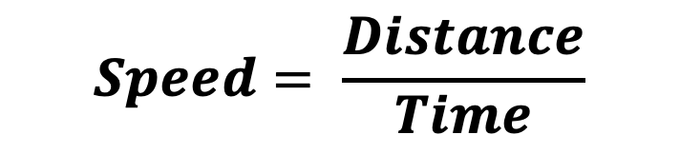
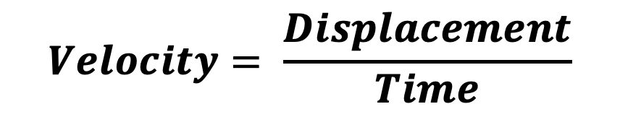
Speed and Velocity
Speed is the distance covered per unit time.
Distance is the length of the path between two points.
$$Speed= \frac{Distance}{Time}$$
Velocity is speed in a given direction.
$$Velocity= \frac{Displacement}{Time}$$
Displacement is how far an object is from its original position or a point of reference in a given direction.
Notes:
Exposition type: explanation
Suggested exposition:
What is the definition of speed?
The distance covered per unit time.
What is the SI unit for speed?
Metres per second (m/s)
What is the definition for distance? (This can actually be quite challenging for pupils to define without using the word distance itself).
The length of the path between two points (how far something has travelled).
What is the equation that links speed, distance and time?
Speed = distance/time
So we know that speed = distance/time. Each of these are scalar quantities because they are fully described by magnitude and do not have a direction.
Velocity is a word you may be familiar with and is often used incorrectly as meaning the same as speed. However this is not quite right - velocity is speed in a given direction, which makes it a vector quantity. A person walking at 1.5 m/s towards the left has a speed of 1.5 m/s but a velocity of 1.5 m/s towards the left. As it is speed with direction, velocity also has the SI units metres per second.
Velocity can be calculated using the equation velocity = displacement/time. But what is displacement? It is how far an object is from its original position in a given direction. That means that if a person walks 200 metres left, their displacement is 200 metres left, as this is relative to their original position. Displacement can also be given in relation to a point of reference, which does not have to be the same as the object’s starting point. For example, another person walked 200 metres right from the same starting point. They have a displacement of 200 m right from the starting point, but 400 m right from the first person. It can be useful to draw out scenarios to make sure that magnitudes and directions are correct.

Slide 9
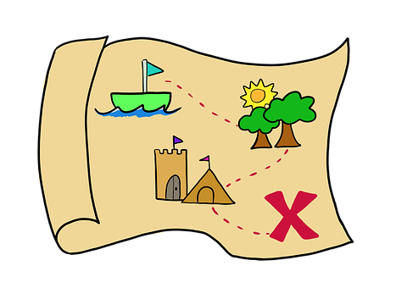
Displacement
Word:
Comes from:
Dis-
-place-
‘apart’ or ‘remove’
‘location’
Definition:
How far an object is from its original position or a point of reference in a given direction.
Notes:
Exposition type: Explanation
Suggested exposition:
The etymology of displacement comes from the French desplacer – to lose or remove from position.
Displacement has a few different uses in science, both in chemistry and physics, but you may also have heard it in a non-scientific context, such as the displacement of a group of refugees from their home country.
In chemistry displacement reactions are ones in which one element or ion takes the place of another, such as when a more reactive halogen displaces another halogen from an aqueous solution of its salt.
In physics (which this unit is part of) displacement is used to describe how far an object is from its original position.
Image source: pixabay

Slide 10
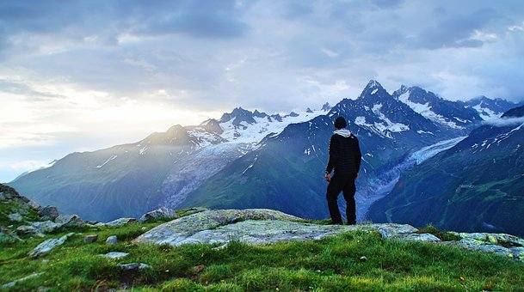
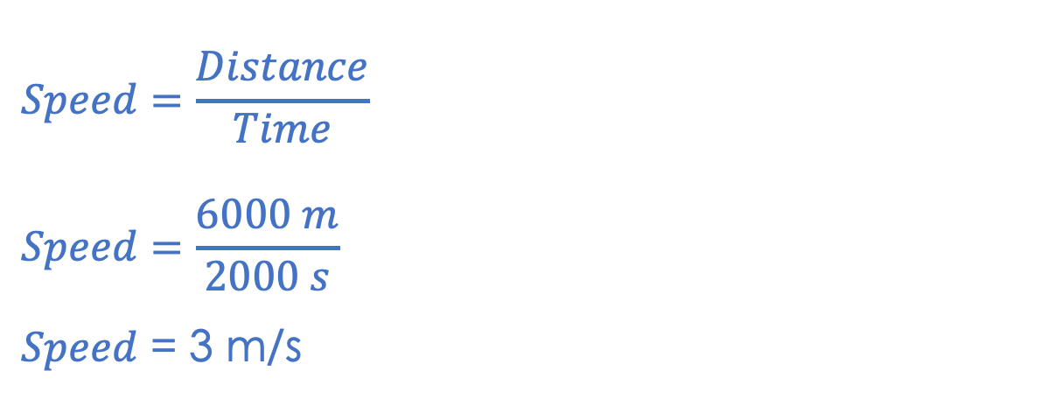
I: Calculating Speed and Velocity
A hiker walks 2000 metres North before realising they have followed the wrong path. They then walk 4000 metres South. The whole journey took 2000 seconds.
What is the distance covered by the hiker?
2000 m + 4000 m = 6000 m
What is the average speed of the hiker?
$$Speed=\frac{Distance}{Time}$$
$$Speed=\frac{6000 m}{2000 s}$$
$Speed$ = 3 m/s
Notes:
Exposition type: explanation
Suggested exposition:
We know that speed is the distance covered per unit time and we can calculate it using speed = distance/time. This hiker may change speed throughout their journey but we can calculate their average speed using the equation average speed = total distance/total time taken. The total distance covered by the hiker is 2000 m + 4000 m, which gives 6000 m.
Using the equation speed = distance/time, we can work out their average speed. 6000 m/2000 s = 3 m/s. This is quite a quick walking pace as normal walking pace is around 1.5 m/s.
Image source:pixabay

Slide 11
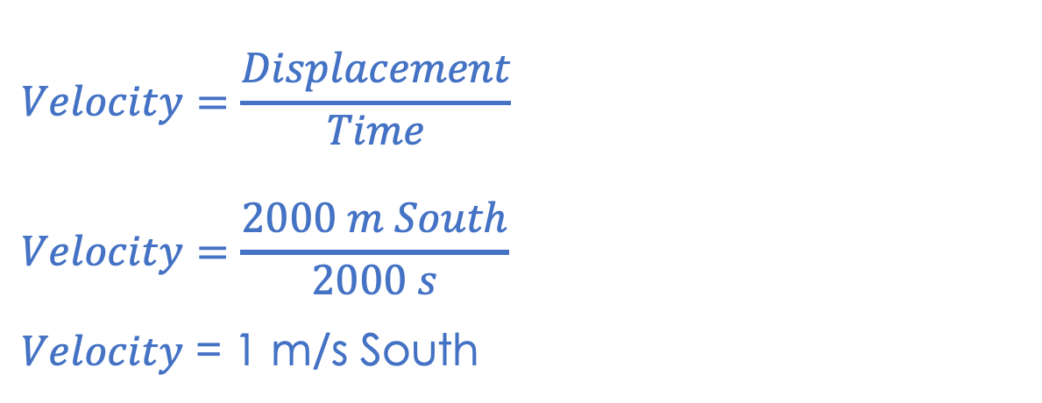
We: Calculating Speed and Velocity
A hiker walks 2000 metres North before realising they have followed the wrong path. They then walk 4000 metres South. The whole journey took 2000 seconds.
What is the displacement of the hiker?
2000 m South
2000 m North
What is the velocity of the hiker?
$$Velocity=\frac{Displacement}{Time}$$
$$Velocity=\frac{2000 m South}{2000 s}$$
$Velocity$ = 1 m/s South
Start
4000 m South
Finish
Notes:
Exposition type: explanation
Suggested exposition:
So we know that speed and distance are both scalar quantities because they are fully described by magnitude (size) only.
Velocity is speed in a given direction and is calculated using velocity = displacement/time. This means that to calculate velocity, we first have to calculate displacement.
Displacement is how far an object is from its original position or a point of reference in a given direction. A point of reference just means any other point that we may want to compare the location to. In this case the hiker walked 2000 m North, followed by 4000 m South. The distance the hiker travelled was 6000 metres but this is not the same as displacement. The hiker has gone back on themselves and then walked further South and the displacement is how far they are from their starting position in a given direction. Comparing the start and finish points of this journey gives us the hiker’s displacement, which is 2000 metres South. Remember this is a vector quantity because it has size and direction. It can be really useful to sketch out the journey so that you can see the directions more easily.
Velocity is speed in a given direction, which means that we can use the equation velocity = displacement/time. In this case we know our displacement is 2000 m South and the time taken for the journey remained the same. This gives us velocity = 2000 m/2000 s, giving a velocity of 1 m/s South. Velocity is also a vector so needs to be described with size and direction.
Image source: pixabay

Slide 12
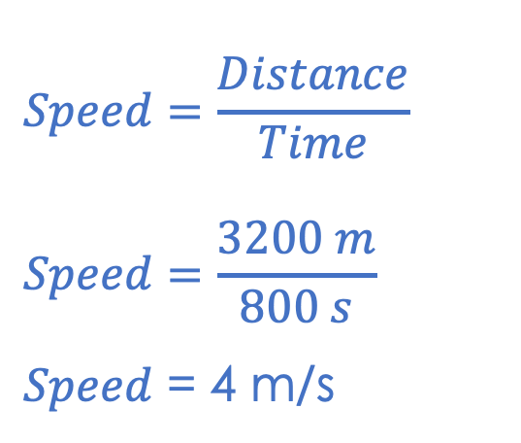
You: Calculating Speed and Velocity
A runner runs 400 metres West then 800 m South. Then they run West again for 1200 m, before finishing with 800 m North. The whole run took 800 seconds.
What is the distance covered by the runner?
400+800+1200+800 = 3200 m
Start
Finish
400 m West
What is the average speed of the runner?
$$Speed=\frac{Distance}{Time}$$
$$Speed=\frac{3200 m}{800 s}$$
$Speed$ = 4 m/s
800 m North
800 m South
1200 m West

Slide 13
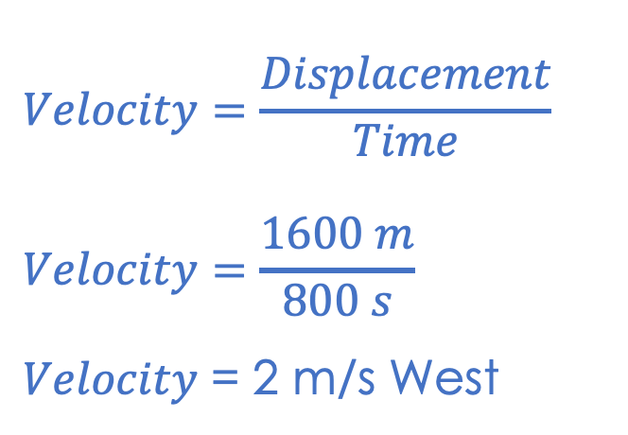
You: Calculating Speed and Velocity
A runner runs 400 metres West then 800 m South. Then they run West again for 1200 m, before finishing with 800 m North. The whole run took 800 seconds.
What is the displacement of the runner?
1600 m West
Finish
400 m West
Start
What is the average velocity of the runner?
$$Velocity=\frac{Displacement}{Time}$$
$$Velocity=\frac{1600 m}{800 s}$$
$Velocity$ = 2 m/s West
800 m North
800 m South
1200 m West

Slide 14
Quick Quiz:
What is a scalar quantity?
What is a vector quantity?
Give an example of a scalar quantity.
Give an example of a vector quantity.
How can speed be calculated?
How can velocity be calculated?
A quantity that has magnitude/size only.
A quantity that has magnitude/size and direction.
Distance, speed, mass, energy
Displacement, velocity, acceleration, force, weight
Speed = Distance
Time
Velocity = Displacement
Time
Notes:
Purpose: review of new information.
MWBs/answer in books and cold call. Accept completely correct answers only.

Slide 15

Can you explain the difference between these two words?
Scalar
What is the definition of each?
Which has a magnitude (size)?
Which has a direction?
Can you give an example of each?
Can you explain why your example is a scalar or vector?
Vector
Notes:
An opportunity for pupils to discuss their understanding of these two new terms. You may want to edit/add/remove questions depending on how much structure you would like to give your class.
Suggested guidance:
Talk tasks can be used in a variety of ways to suit the particular needs of the students you are teaching. Through exchanging views with others, students develop their understanding of the science beyond what could be achieved individually.
Science classrooms that successfully integrate talk have the following features:
Science talk is a regular feature of lessons and is woven into classroom activities.
Students are paired or grouped strategically by the teacher to ensure productive interaction. This might take into consideration the students’ proficiency of the English language, how encouraging they might be to peers and their attainment in the topic. It’s a good idea to consider these pairings in the class seating plan.
Students are encouraged and supported to talk, but are not forced to talk.
The teacher should take on the role of a facilitator, engaging with conversations where necessary and encouraging or steering the conversation where needed.
Students are encouraged to use the language they have to express their ideas (e.g., everyday language, imperfect English, native language), but also to incorporate science specific terminology where this is more accurate or has been taught.
6. Scientifically inaccurate ideas are not dismissed by the partner or teacher; open discussion and further investigation are relied on to help students construct ideas that support them to progress in their scientific understanding.
7. Guidelines for behaviour during talk tasks are explicit and frequently reviewed. Rules for students might be:
Listen carefully to your partner
Take turns talking.
Speak one at a time, without interrupting.
Politely agree or disagree and explain why.
Politely point out if your partner has used a scientific word incorrectly, if they have explained the science incorrectly, or if there is a more accurate way to describe something.
If confused, ask questions.
Stay focused on the discussion topic.
Respond to one another.

Slide 16




Which statements do you agree with?
I think that mass is scalar because it does not have a direction.
I think that mass and weight are both scalars because they do not have directions.
I think that weight is a vector because it is a force.
I think that mass and weight are both vectors because they both act downwards.
Notes:
Guidance - this is an opportunity to check that pupils can apply new knowledge of the difference between scalars and vectors to other quantities they will already know about.
Blue: incorrect - mass is a scalar but weight is a vector because it is a force and forces have direction.
Yellow: correct - scalars are quantities that are fully described by magnitude (do not have direction).
Green: correct
Pink: incorrect - weight acts downwards (or rather towards the centre of the Earth) as it is a force so has a direction but mass does not act in a direction, it is merely the amount of matter in an object.
Suggested guidance:
Talk tasks can be used in a variety of ways to suit the particular needs of the students you are teaching. Through exchanging views with others, students develop their understanding of the science beyond what could be achieved individually.
Science classrooms that successfully integrate talk have the following features:
Science talk is a regular feature of lessons and is woven into classroom activities.
Students are paired or grouped strategically by the teacher to ensure productive interaction. This might take into consideration the students’ proficiency of the English language, how encouraging they might be to peers and their attainment in the topic. It’s a good idea to consider these pairings in the class seating plan.
Students are encouraged and supported to talk, but are not forced to talk.
The teacher should take on the role of a facilitator, engaging with conversations where necessary and encouraging or steering the conversation where needed.
Students are encouraged to use the language they have to express their ideas (e.g., everyday language, imperfect English, native language), but also to incorporate science specific terminology where this is more accurate or has been taught.
6. Scientifically inaccurate ideas are not dismissed by the partner or teacher; open discussion and further investigation are relied on to help students construct ideas that support them to progress in their scientific understanding.
7. Guidelines for behaviour during talk tasks are explicit and frequently reviewed. Rules for students might be:
Listen carefully to your partner
Take turns talking.
Speak one at a time, without interrupting.
Politely agree or disagree and explain why.
Politely point out if your partner has used a scientific word incorrectly, if they have explained the science incorrectly, or if there is a more accurate way to describe something.
If confused, ask questions.
Stay focused on the discussion topic.
Respond to one another.

Slide 17
Drill
What is a scalar quantity? What is a vector quantity?
What is the difference between speed and velocity? What is displacement?
You travel in a circle for one kilometre, you then rest for two minutes and then travel three more kilometres. You reach the start of the circle. What was the distance travelled in this circle?
You travel in a circle for one kilometre, you then rest for two minutes and then travel three more kilometres. You reach the start of the circle. What was the displacement travelled in this circle? What equation is used to calculate speed? What equation is used to calculate velocity? What is your velocity if you travel due east for 100m and 10s?
Notes:
Purpose: This is a knowledge drill. The purpose of this is to check that the critical knowledge is secure before pupils move onto independent practice.
Suggested guidance: There are a range of ways this could be done depending on time and ability range of the class:
Mini whiteboards
As full sentences in exercise books
As short answers in exercise books
In the pupil workbook
As pair talk
As cold call

Slide 18
Drill answers
A scalar quantity only has magnitude/size A vector quantity has magnitude/size and direction Speed is a scalar quantity whereas velocity is a vector quantity Displacement is how far an object travels from its original position two point of reference in a given direction 1 + 3 = 4 km
0 km as you travelled back to the original position in the circle
Speed= distance
Time
Velocity = displacement
Time
Velocity = 100 m= 10m/s
10s
Notes:
Purpose: This is a knowledge drill. The purpose of this is to check that the critical knowledge is secure before pupils move onto independent practice.
Suggested guidance: There are a range of ways this could be done depending on time and ability range of the class:
Mini whiteboards
As full sentences in exercise books
As short answers in exercise books
In the pupil workbook
As pair talk
As cold call

Slide 19
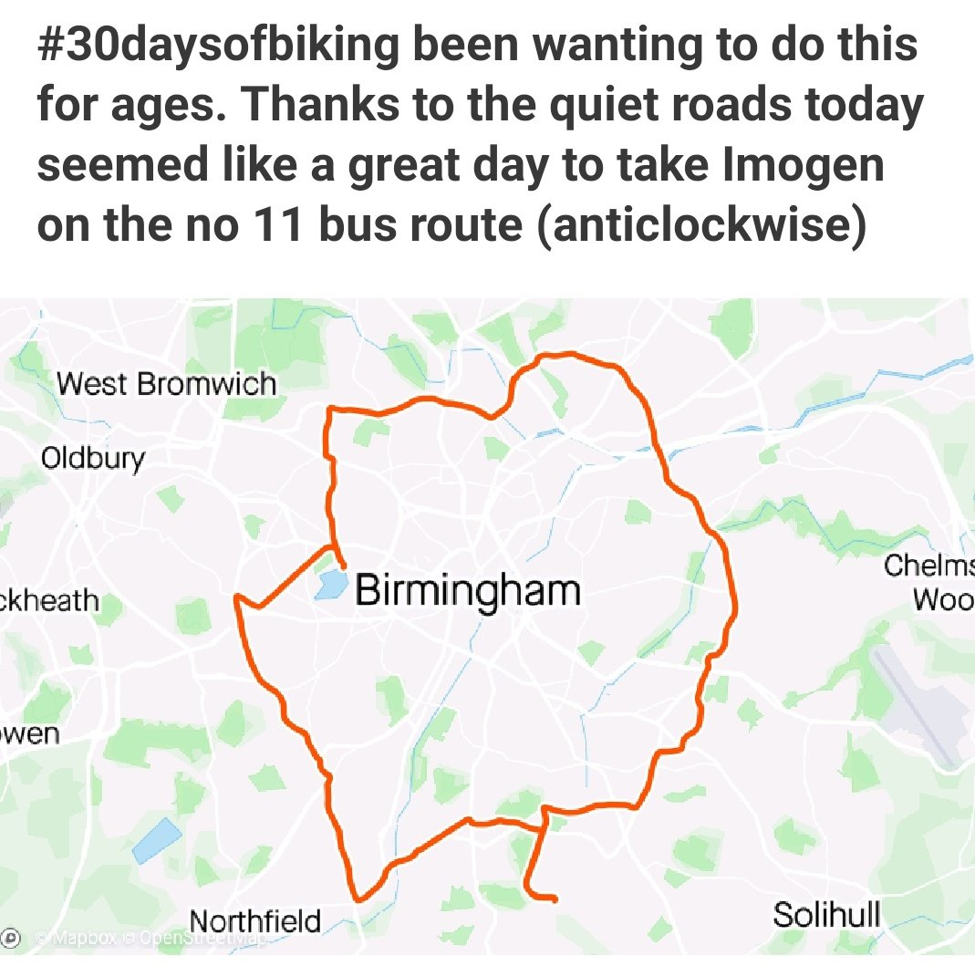

Explain: to use scientific understanding to make something clear or state the reason for something happening
Example question:
To ‘explain’ your answer should:
Begin with a scientific statement.
Use ‘this means that’, ‘because’ or ‘so’ to link your statement to the question.
This is the biggest bus route in Europe at a distance of 26 miles. Explain how this route has a displacement of zero.
Model answer:
Displacement is how far an object travels from its original position two point of reference in a given direction.
Displacement will be zero if you start in Northfield, move clockwise and finish in Northfield. This is because you have travelled in a particular direction and you have travelled from the original position back to the original position.
Notes:
This slide models the process of answering an explain question.
Firstly, students are presented with a generic explain question, along with a model answer. Students are also given some simple guidance to follow for producing their own describe answer.
The generic question and answer should be used by the teacher to remind students of
the key features of a great answer
how to structure their answer
why the model answer is a good example
Following this, students will be required to apply this process to answer their own explain question, which will appear in place of the generic questions. This explain question will be specific to the topic students are learning about in the lesson. Give students time to write their own answer to this, ensuring that they use the guidance provided. To further scaffold this task for students, it may be appropriate to:
pair students up to write an answer together
list for students the key words you would like them to include in the answer
provide a writing frame or ‘points to include’ for students
A model answer for this question will appear. Teachers should review the model answer with students by referencing the guidance in the green box. For example ‘we can see item 1 in the guidance is to begin with a scientific statement. Notice in the model answer here we have done just that’. Or ‘item 2 in the guidance here says that we should use a linking statement in the answer. Has this been achieved in the model answer? Where can we see this?’.

Slide 20
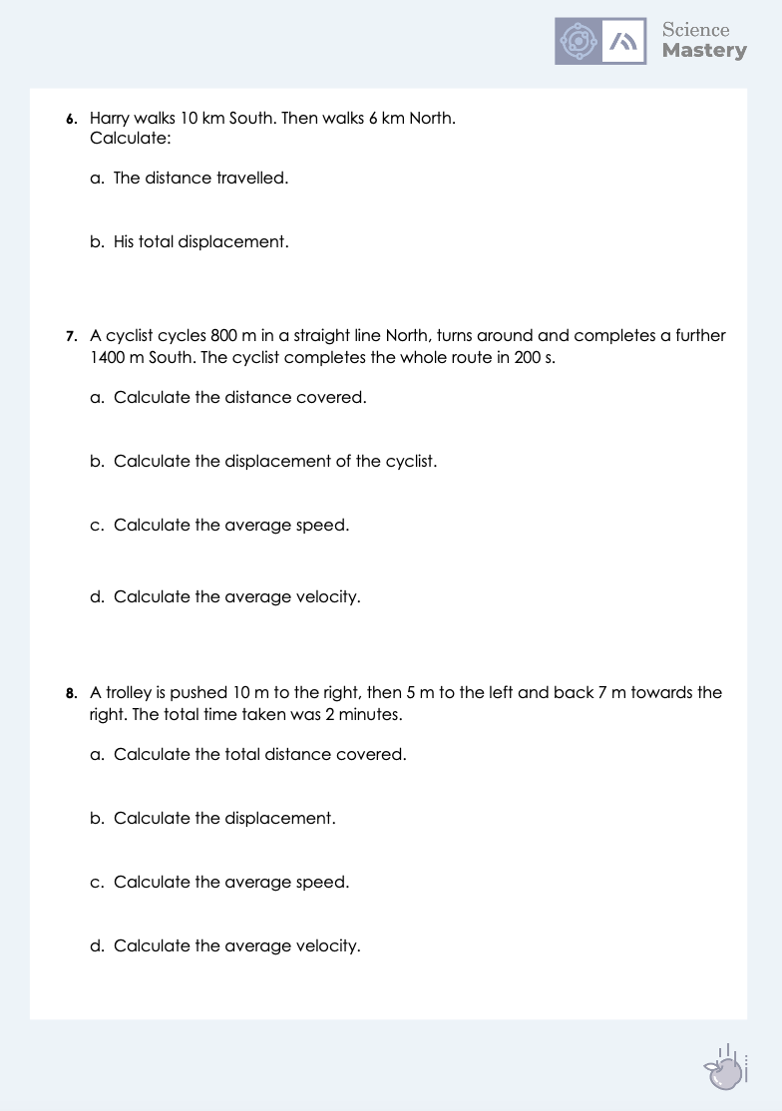
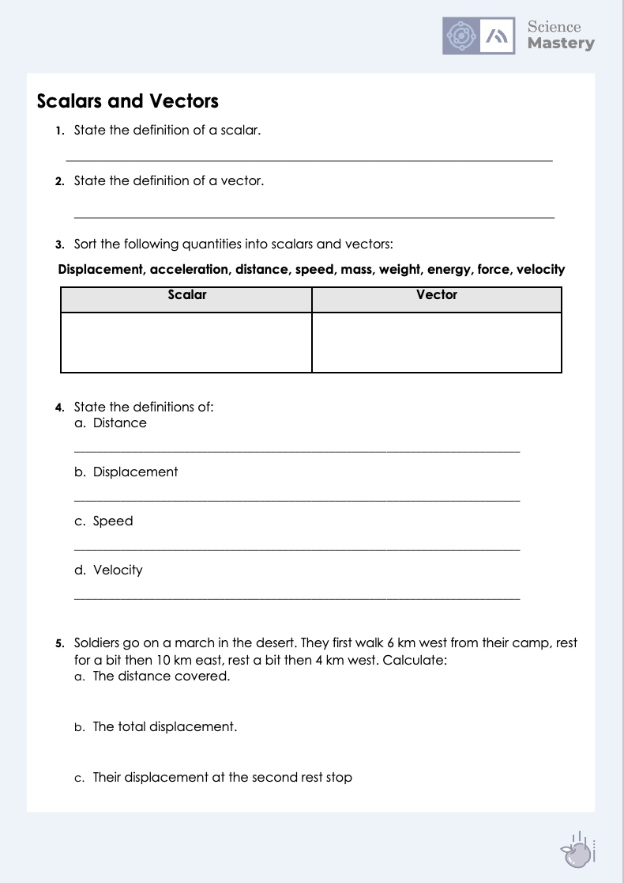
Scalars and Vectors
Complete the activity.
State all equations where you use them and remember to include units.
Ensure you include directions for any vector quantities.
Notes:
Purpose: practice application of new knowledge.
Self assess or peer assess using markscheme provided.
Depending on the ability of your class you may want to model a calculation or example of each type of question for the class before they attempt to complete them independently.

Slide 21
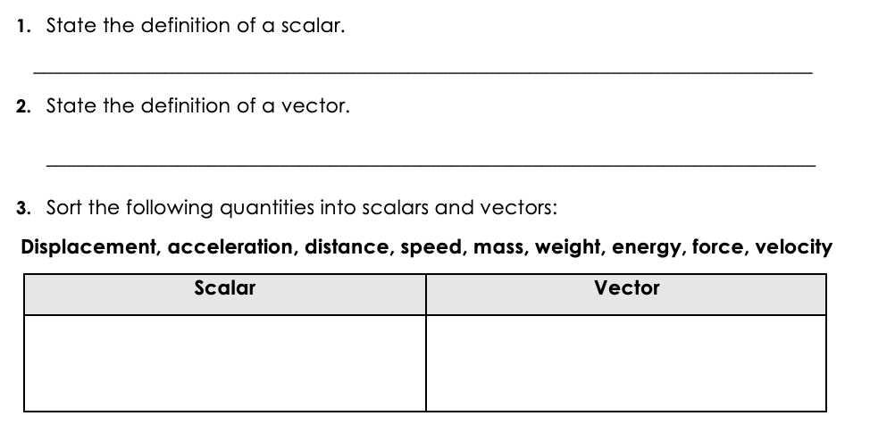
Answers
A quantity that has magnitude/size only.
A quantity that has magnitude/size and direction.
Distance, speed, mass, energy
Displacement, acceleration, weight, force, velocity

Slide 22
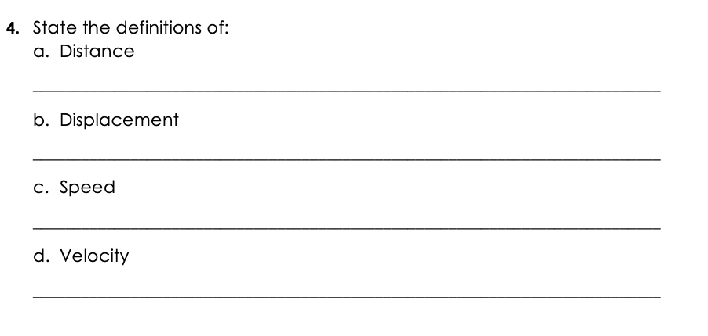
Answers
How far an object has travelled.
The position of an object relative to its starting point or another object.
How far an object travels in a given time.
How far an object travels in a given direction in a given time (speed with direction).

Slide 23
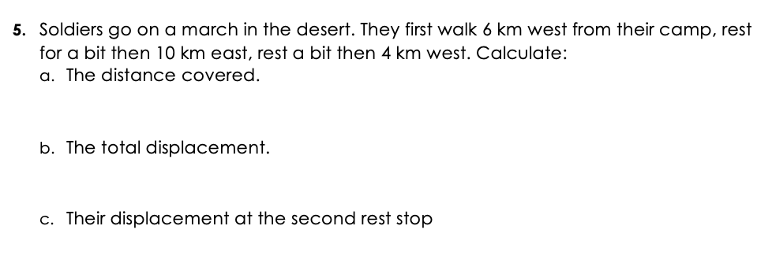
Answers
Distance = 6 km + 10 km + 4 km
= 20 km
Displacement = 10 – (6+4)
= 0 km (the soldiers have returned to the same place).
Displacement = 4 km East

Slide 24
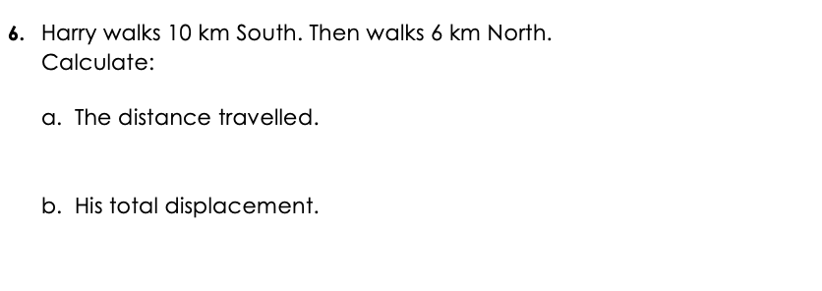
Answers
Distance = 10 km + 6 km
= 16 km
Displacement = 4 km South

Slide 25
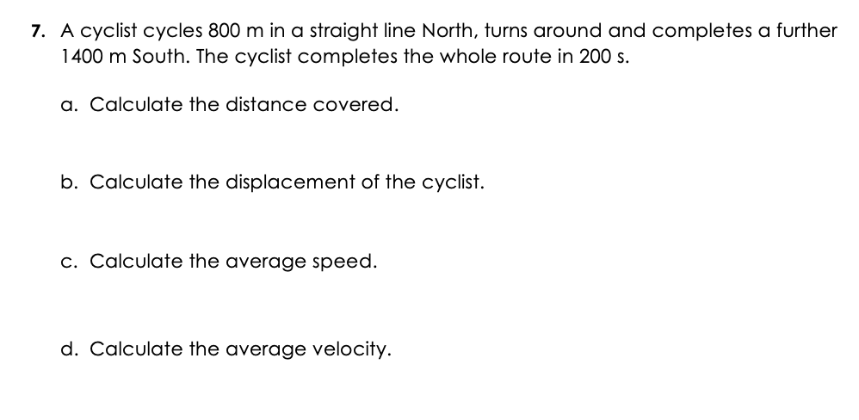
Answers
Distance = 800 m + 1400 m
= 2200 m
Displacement = 600 m South
Average speed = Total distance/total time taken
= 2200 m/ 200 s
= 11 m/s
Average velocity = displacement/time
= 600 m South/ 200 s
= 3 m/s South

Slide 26
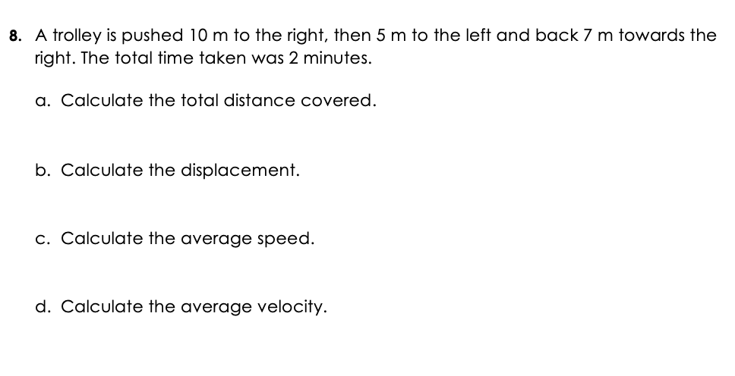
Answers
Distance = 10 m + 5 m + 7 m
= 22 m
Displacement = 12 m right
Average speed = total distance/total time taken
= 22 m/120 s
= 0.18 m/s
Average velocity = displacement/time
= 12 m right/120 s
= 0.1 m/s right

Slide 27
Answer the questions below.
1. Velocity is a vector quantity because…
A. It is has magnitude/size and direction
B. It has magnitude/size only
C. It is how much distance is covered in a given time
2. If a person walks 4 m left then 8 m right…
A. Their displacement is 12 m right
B. Their displacement is 4 m right
C. Their displacement is 4 m left
3. What would the velocity of the person in Q2 be if they completed these movements in 8 seconds?
A. 1.5 m/s right
B. 0.5 m/s
C. 0.5 m/s right
✓
✓
✓
Notes:
Suggested Guidance:
Q1. Answer: A
If students answer B they have confused scalar and vector quantities and if students answer C they have confused speed and velocity. To fix-it, practice speed and velocity calculations and explain in each case why they are scalars and vectors.
Q2. Answer: B
If students answer A they have calculated distance rather than displacement. If students answer C they have subtracted but their direction is incorrect. To fix-it, practice distance vs displacement calculations from described journeys.
Q3. Answer: C
If students answer A they calculated the speed rather than the velocity. If students answer B they have correctly calculated velocity but not remembered it is a vector quantity so must have a unit. To fix-it, practice questions calculating speed vs velocity and explain the difference between them.

Slide 28
Lesson P3.1.2
What was good about this lesson? | What can we do to improve this lesson?
Send us your feedback by clicking this link
or by emailing sciencemastery@arkonline.org
Thank you!

